Slide 1
2023 HTS Coaches Conference
Daruvar, Croatia
tennistalents.net

Slide 2
“THE USE OF REVERSED PEDAGOGY IN TENNIS TEACHING AND COACHING”
according to the
TENNIS TALENTS METHOD
by Luca Appino

Slide 3
LET’S START
FROM THE OUTCOME

Slide 4
REVERSED PEDAGOGY
start from outcome vs movement “art” and science of teaching, educate
proposes to develop the technique, guiding each player, to accomplish a desired outcome (task) instead of teaching standard, one fits all, movement.
a way to enhance individual’s skill-learning by manipulating tasks and constraints within representative situations

Slide 5
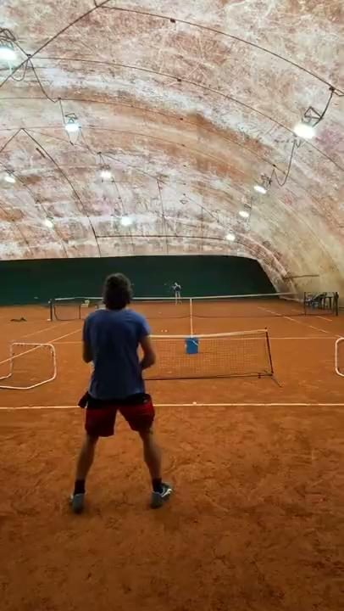

Slide 6
TECHNIQUE (tennis)
Ability to learn, develop and stabilize sequences of movements, functional to perform effective and efficient strokes
STYLE
Personal interpretation/adjustment to express technical skills (form, size, timing, etc.)

Slide 7
REVERSED (non-linear) PEDAGOGY
a practical application of the
Dynamic Systems Motor Learning Theory
TASK
PLAYER
NEW/REINFORCED SKILL ACQUISITION
CONSTRAINT
ENVIRONMENT

Slide 8
DYNAMIC SYSTEMS
MOTOR LEARNING THEORY
sport movements are performed in reason of the interaction of complex internal systems, led by the CNS, within a given environment.
the human body better organizes “personal” motoric actions, according to the situation, having a precise task and relevant constraint(s) to guide its execution!

Slide 9
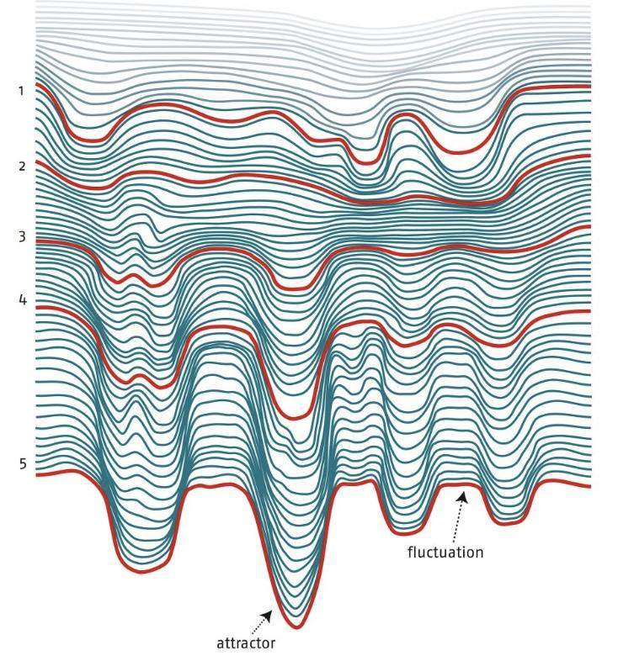
DYNAMIC SYSTEMS
MOTOR LEARNING THEORY
training = repetition
leads to the development of “attractors”
(functional, or dysfunctional, sequences/patterns of movement)

Slide 10
teaching
GOAL
is to master the shots in order to control where and how the ball goes in the opponent’s court
HOW TO GET CLOSER TO THE DESIRED OUTCOME?

Slide 11
OUTCOME
PLAYER (individuality)
SITUATION/ENVIRONMENT
INTENTION
ALL HAPPENS WHEN HITTING THE BALL
DIRECTION OF THE SWING
SPEED OF THE SWING
RACQUET HEAD INCLINATION
PERSONAL TOUCH/BALL FEEL

Slide 12
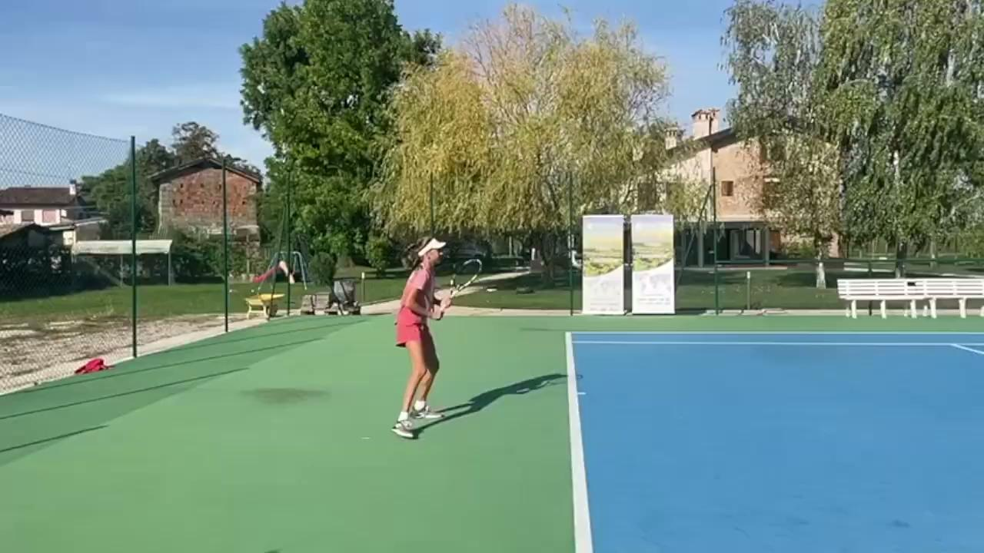

Slide 13
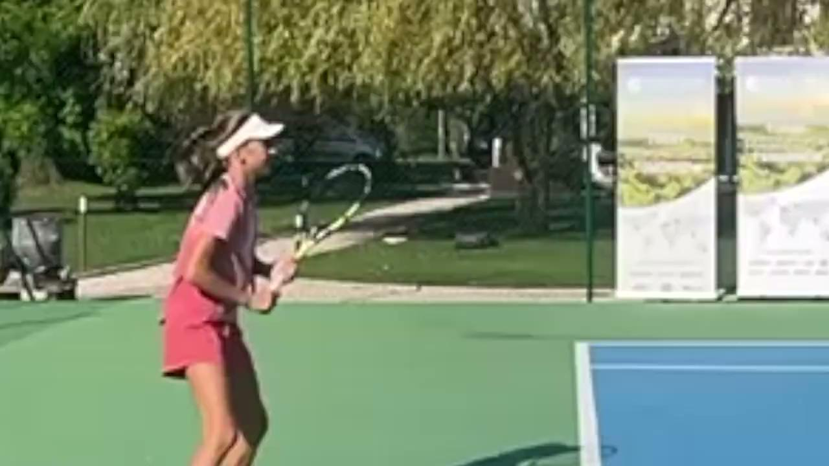

Slide 14
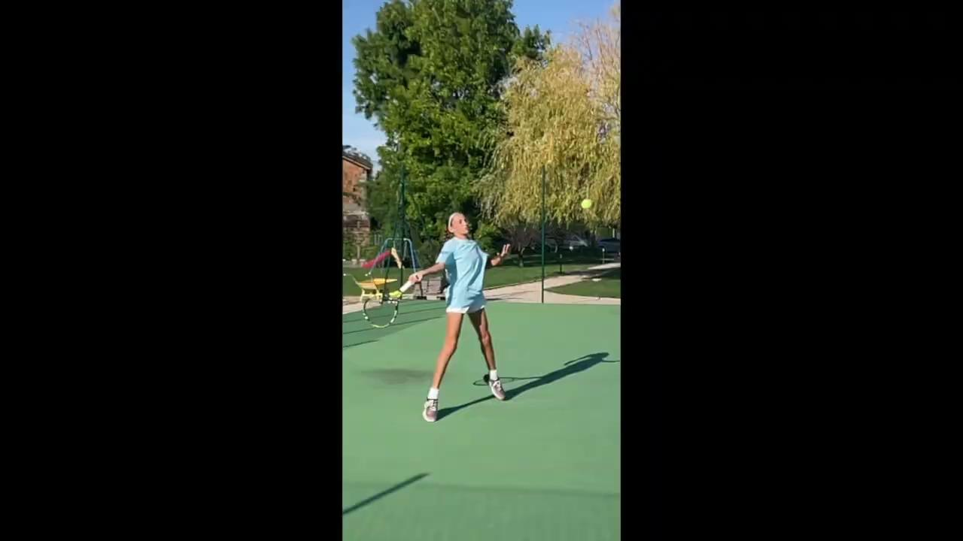

Slide 15
PRECISION
A key factor to be precise is the stability of the racquet head at the impact with the ball.
MAGIC 20 cm
The application of Reversed Pedagogy in training helps to stabilize the movements by creating situations that stimulate body and mind interaction.

Slide 17
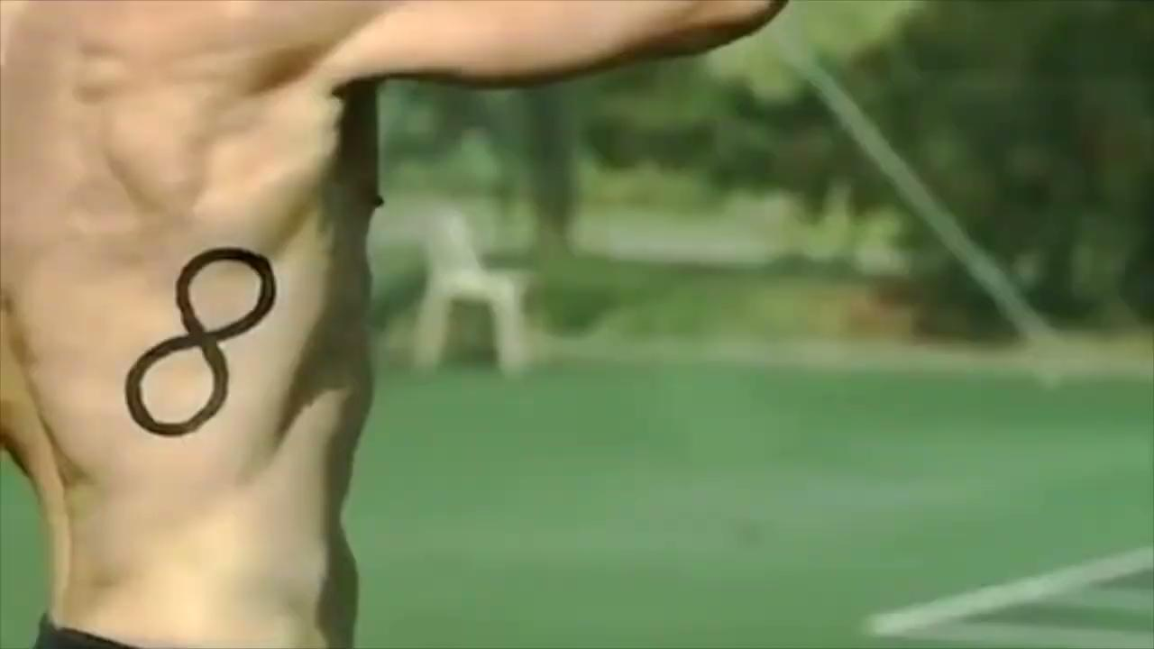
100 km/h forehand top spin
contact time approximately 3 ms
contact length approximately 3.8 cm

Slide 18
ON COURT APPLICATION
Pedagogical approach to drills:
DECIDE A TASK
CREATE A SCENARIO WITH THE HELP OF CONSTRAINT(S)
EXPLAIN AND/OR SHOW IT
EVALUATE THE AVERAGE OUTCOME
SIMPLIFY OR COMPLICATE THE TASK ACCORDING TO THE LEVEL OF PERFORMANCE
*Use tests to monitor the evolution

Slide 19
coaching
?
2023 WIMBLEDON
Ladies & Gents
¼ FINALIST
HOW MANY OF THEM
WON MORE POINTS WITH
the 1st vs the 2nd SERVE?

Slide 20
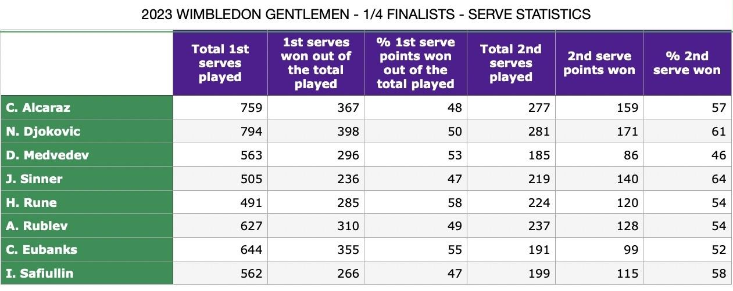
ONLY 3 GENTLEMEN !
1
2
3

Slide 21
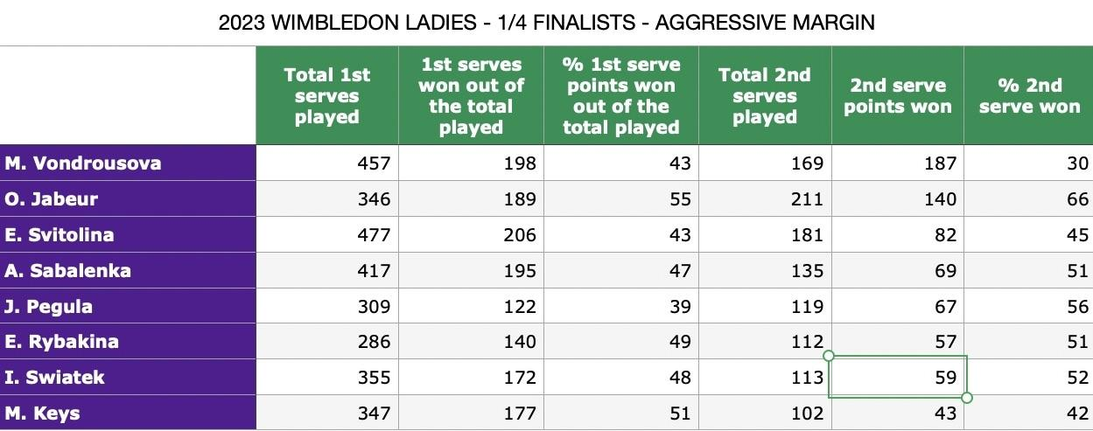
ONLY 2 LADIES
1
2

Slide 22
Q&A

Slide 23
ON COURT APPLICATION
Drills:
A
TASK: RALLY WITH MARGIN (OVER NETS)
CONSTRAINTS: 1 HIGH NET + 1 MINI NET (ball over both, but bouncing in between them)
SCENARIO: 3rd SET, 5-6 DEUCE: 4 BALLS SURELY IN
B
TASK: KICK SERVE, HIGH BOUNCE
CONSTRAINT: HIGH NET ON THE BASELINE (ball over it)
SCENARIO: 1st GAME, 30-15: DO IT AS 1st SERVE
C
TASK: FEED 10 BALLS PRECISION DRILL
CONSTRAINT: WITHOUT THEN WITH
SCENARIO: TRACK THE FIRST RESULT AND CHECK IF WITH CONSTRAINTS IT IMPROVES

Slide 24
HVALA VAMA!
info@tennistalents.net
www.tennistalents.net

